Slide 1

Assignment 12.2 Exploratory Data Analysis
Atanu Basak

Slide 2
Loan Data Analysis
This is a real loan data information, collected from Kaggle for Analysis Purpose, it has several attributes, but for doing further analysis I have selected the below 6 attributes.
purpose : The purpose of the loan
Installment : No. of installment paid
int.rate : Interest rate for the loan
fico : FICO score of the applicant who applied for the loan
revol.bal : Revolving balance for laon
not.fully.paid : Account has been delinquent or not

Slide 3
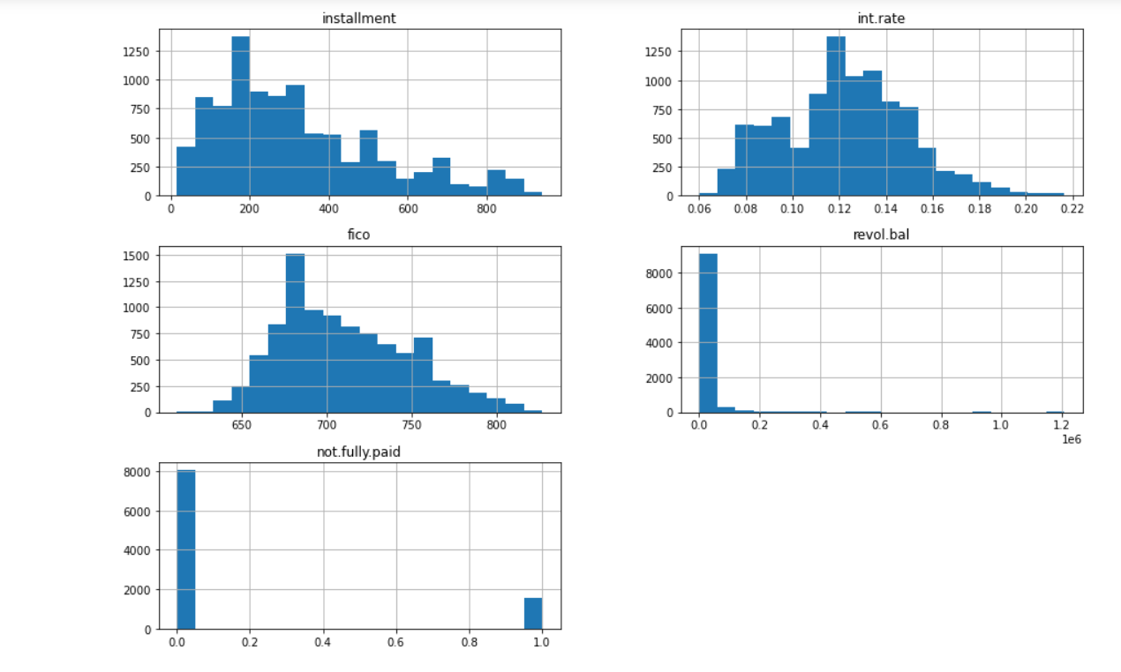
Histogram of the attributes
Here is the histogram of all the five attributes, selected for analysis. Looking at the histogram we can say interest rate follows nearly normal distribution, but both the installment and fico have some skewness in the overall distribution.

Slide 4
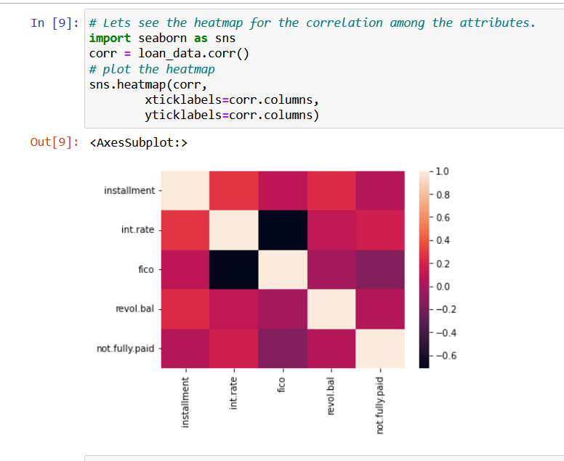
Correlation Heatmap
Here is the correlation heatmap for all the attributes. Looking at the map we can say that there is a strong negative correlation between fico and interest rest, i.e higher the fico means less interest rate for loan. Other than that only fico have some correlation on delinquency (fully paid or not) i.e. loans with less fico have more chances to be delinquent.

Slide 5
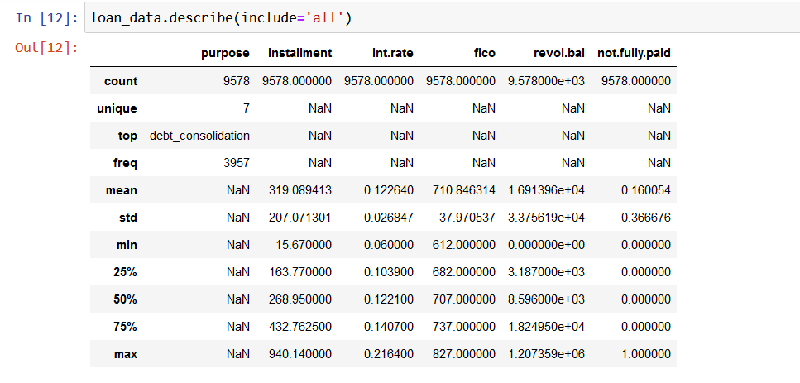
Descriptive Statistics
Here are the list of descriptive statistics, like mean , deviation , quantiles and frequency for all the attributes.

Slide 6
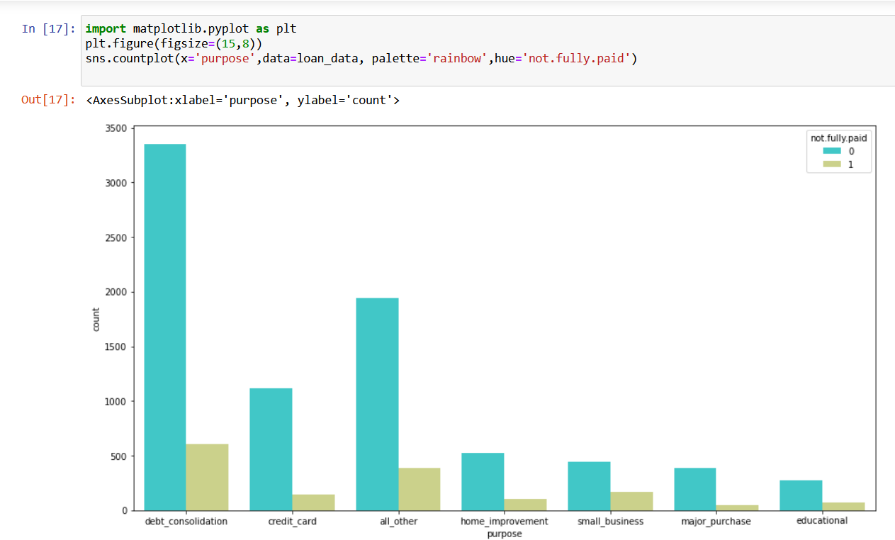
Categorical Attribute analysis
There is one categorical variable which explains the purpose of the loan, Here is the bar diagram of the variable purpose grouped in two categories, defaulters and non defaulter, but it looks like the purpose of the loan does not have much effect on that.

Slide 7
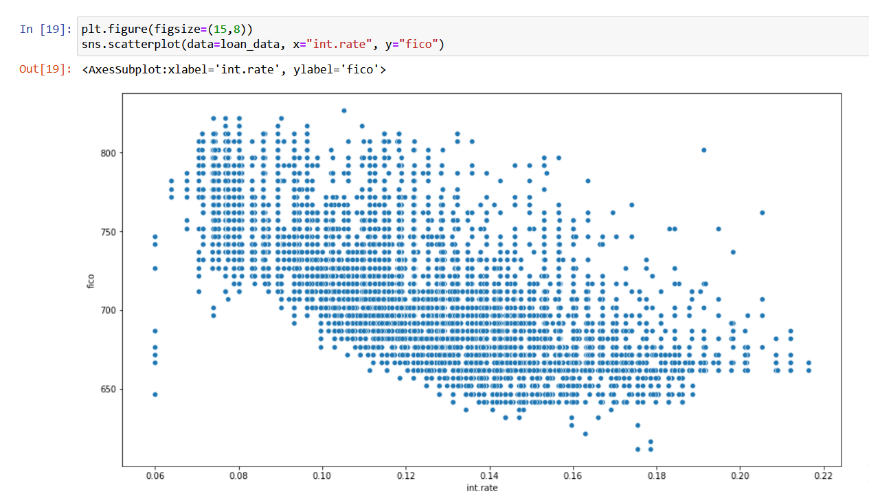
Do interest rate and FICO really correlated?
Here is the scatter plot of interest rate and FICO score, which clearly say that there is a negative correlation between the two, i.e higher fico socre means less interest rete and lower fico means for the loan interest rate will be high.

Slide 8
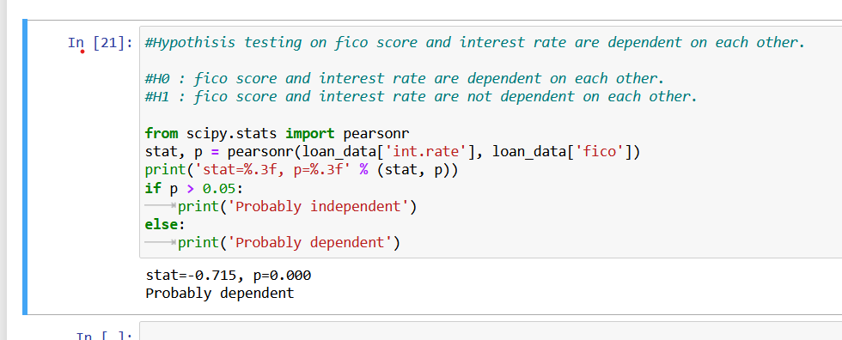
Hypothisis testing on FICO
H0 : fico score and interest rate are dependent on each other.
H1 : fico score and interest rate are not dependent on each other.
After doing the hypothesis testing it says the same thing, that FICO and interest rate are dependent on each other.

Slide 9
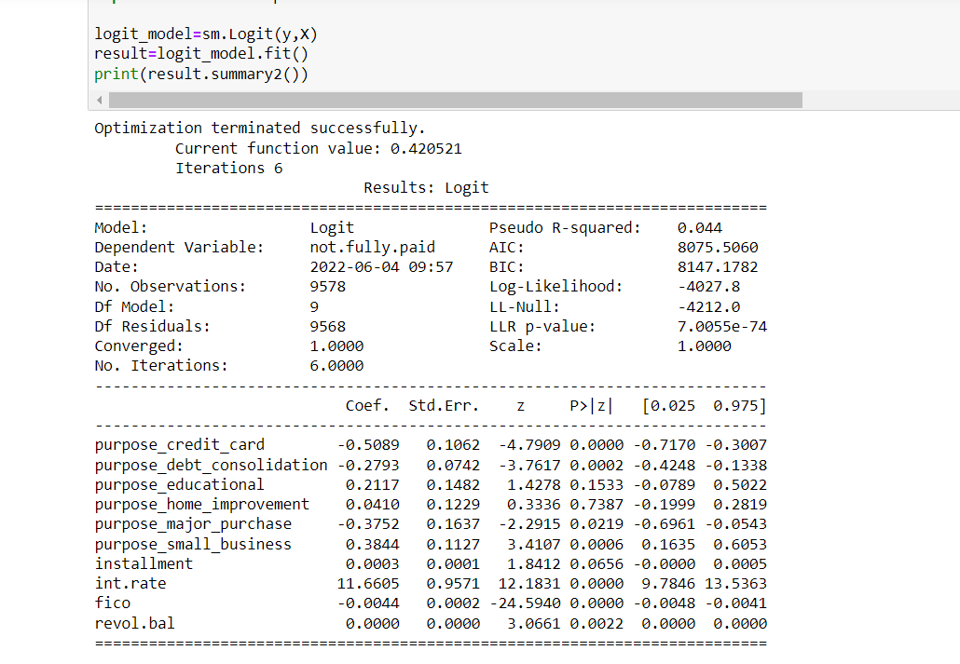
Regression Analysis
Here is the logistic regression model, where all the attributes mentioned here are independent variable and not.fully.paid is dependent variable. One hot encoding has been done for the categorical field purpose of the loan. Looking at the p values it looks loan for the purpose of credit_card, small business and debt_consolidation are highly significant effect on default attributes. Among the other attributes FICO and interest rest have effect on defaulters.

